Slide 1
Capstone Project TED-Talks views prediction
By- Ayush Ambhore

Slide 2
Points for discussion
Problem Statement
Data summary
Data Modeling
Exploratory Data Analaysis
Correlation Heatmap
Metrics Dataframe of all models before hyperparameter tuning
Metrics Dataframe of all models after hyperparameter tuning
Model Selection
Challenges Faced
Conclusion

Slide 3
Problem statement
Develop a predictive model for estimating the number of views for TEDx website videos.
Analyze various factors related to the videos to understand their impact on popularity.
Perform data preprocessing, feature engineering, and exploratory data analysis.
Leverage available data to identify patterns and relationships.
Create a model that provides valuable insights and predictions.
Gain meaningful insights into the dataset.

Slide 4
Data summary
talk_id : Unique ID
title : Title of the video
speaker_1: Main speaker in the video
all_speakers : name of all speakers in the video
occupations: occupations of the main speaker
about_speakers: description about the speakers
views : total views on the video
recorder_date: the date of the recording of the video
published_date : date of publish of the video
event: event name
native_lang : the language in which the video was recorded
available_lang : available languages for the video
comments : total comments on the video
duration : duration of the video
topics : topics related to the video
related_talks : ID and the name of the related TED video
url : url link of the video
description : description of the video
transcript: transcript of the video

Slide 5
Data modeling
Dataset: 4005 rows, 19 columns
Data Cleaning:
Dropped rows with missing values in the "all_speakers" column (indicated one speaker)
Replaced missing values in "occupations" and "about_speakers" with "NA"
Dropped row with missing value in "recorded_date" column
Replaced missing values in "comments" column with zeros

Slide 6
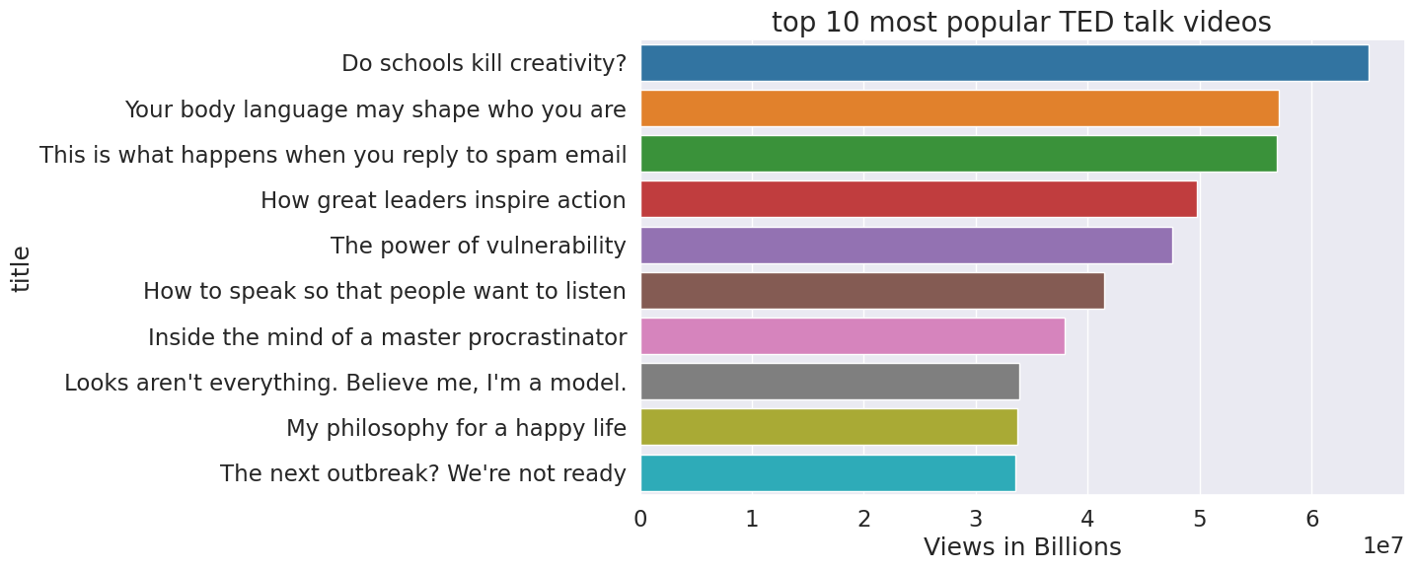
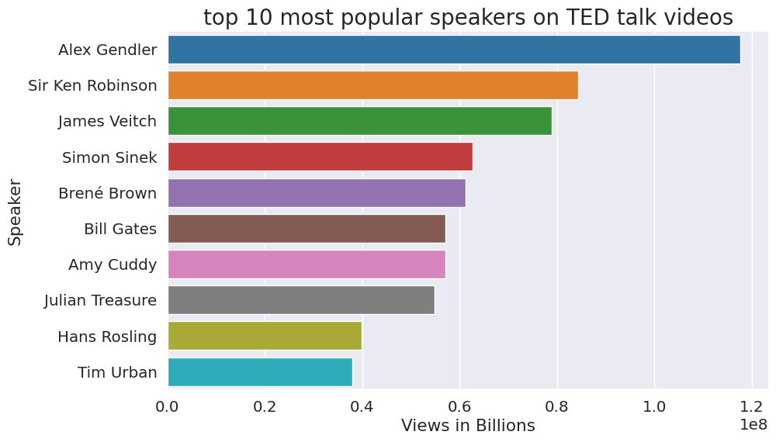
Exploratory Data analysis
As we can see the most popular video is the 'Do schools kill creativity?’
The new content creators should note that people are more interested in these 10 topics so they should make more content on this.
As we can see the top most popular speaker is Alex Gendler .
The TED organization should approach these speakers more as they are bringing the most views to their videos.

Slide 7
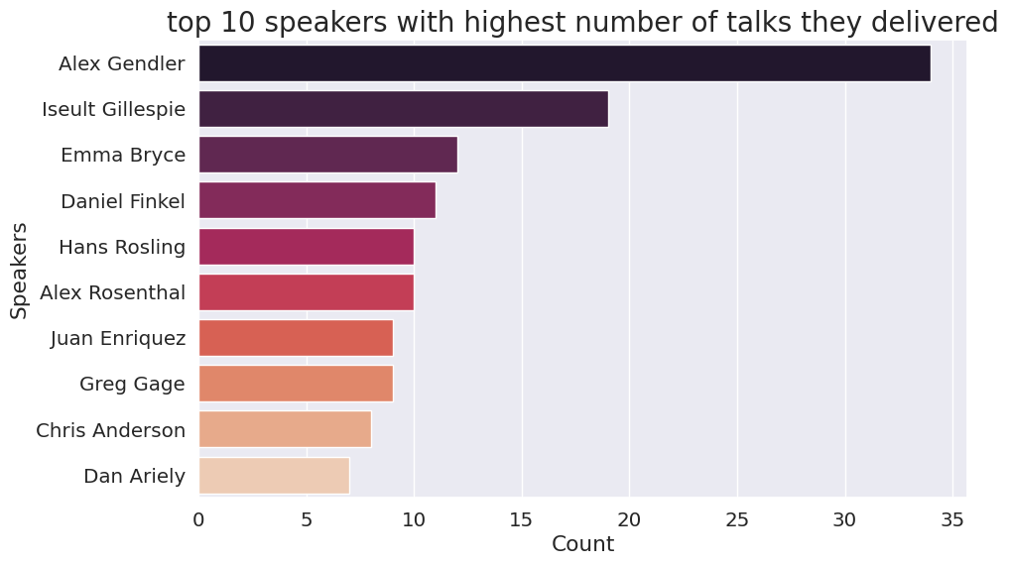
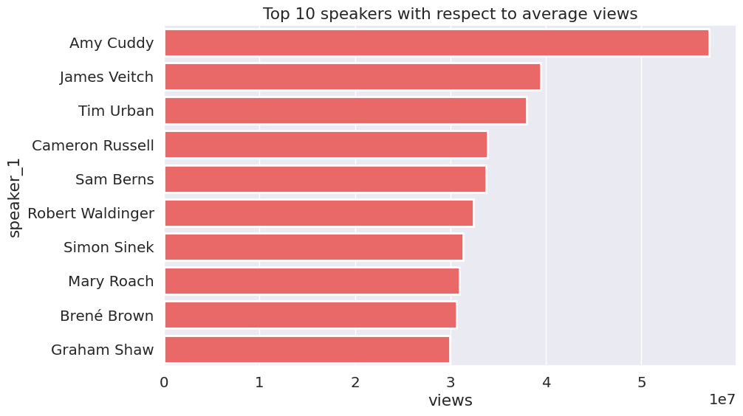
Alex Gendler has delivered the highest number of talks.
Amy cuddy has the highest average views among all the speakers.
The TED organization should approach these speakers more as they have the highest average views.

Slide 8
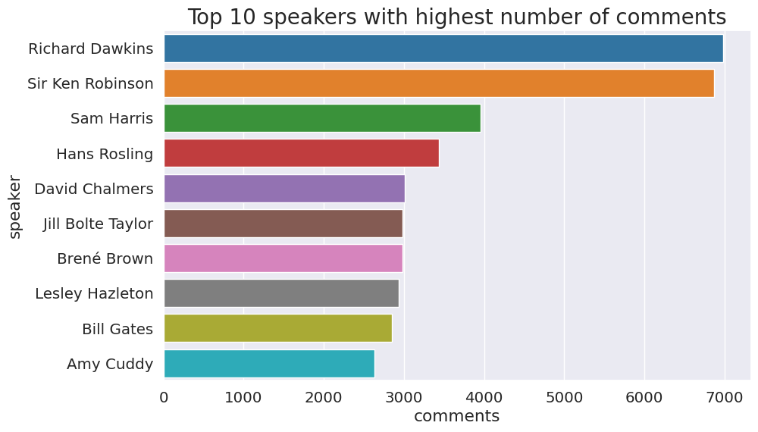
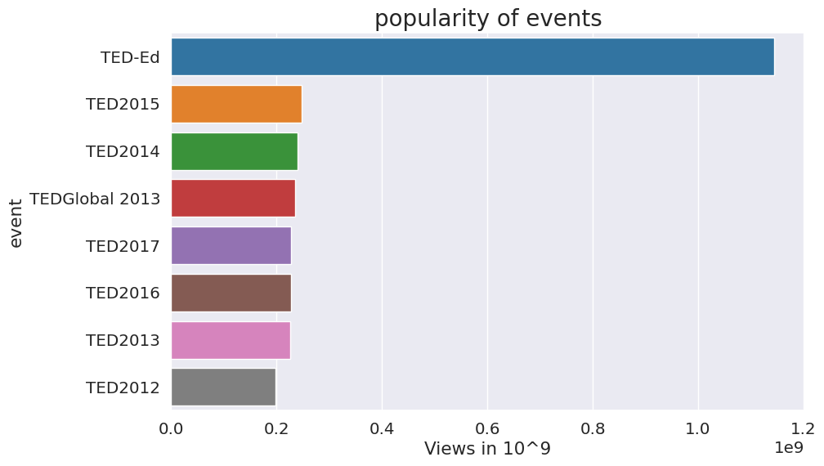
Richard Dawkins have the most number of comments on his videos.
As we can clearly see the most popular event is TED-ed

Slide 9
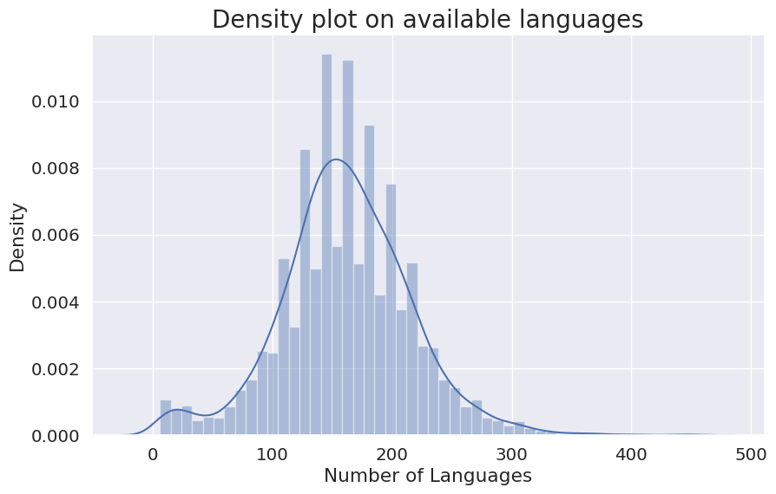
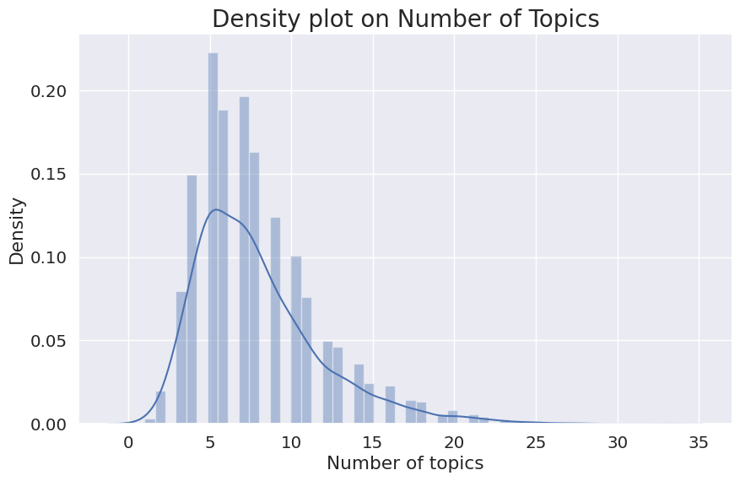
We can conclude from the chart that more number of videos have number languages between 100 to 250.
we can see that more number of videos have around 2 to 10 topics.

Slide 10
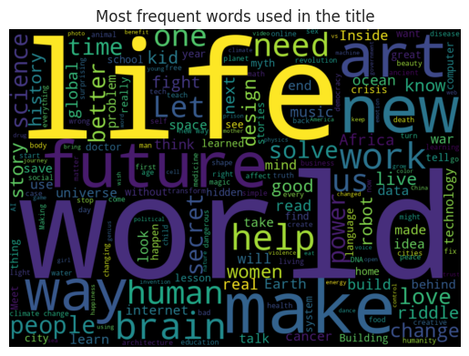
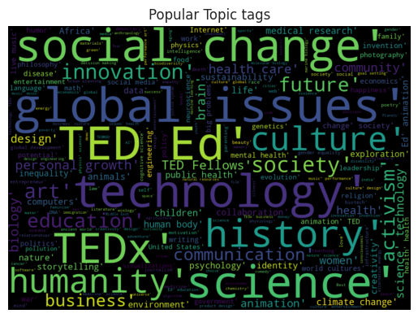
We can see the that world and life are the most occuring words in the titles.
We can see that technology,science and global issues and TED ed are the most occuring words in the topics.

Slide 11
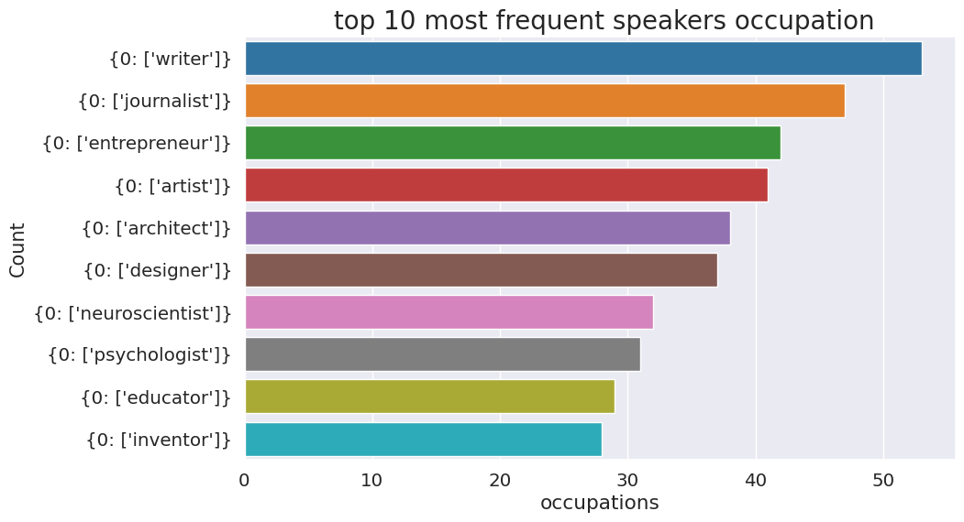
Writer is the most popular occupation of the speakers.

Slide 12
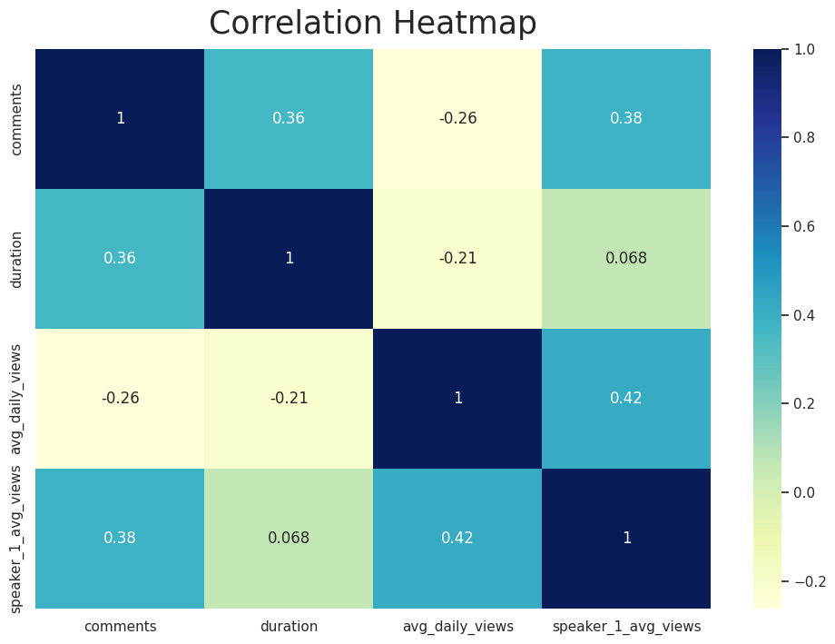
Correlation Heatmap
We can see that avg_daily_views and speaker_1_avg_views have a positive correlation and theres is not multicollinearity between them as we saw the VIF came below 5.
I dropped the views column as it is our dependent variable.

Slide 13
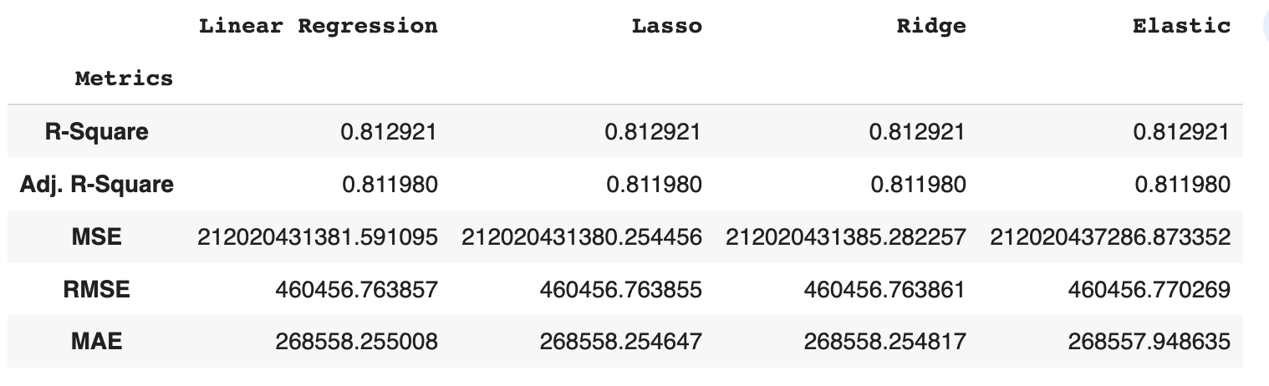
Metrics Dataframe of all models Before hyperparameter tuning

Slide 14
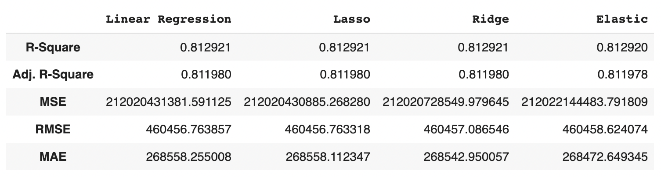
Metrics Dataframe of all models After hyperparameter tuning

Slide 15
Model selection
R2 metric consistently produced the best results in evaluating the regression models.
No indication of overfitting was observed, as indicated by the consistent adjusted R2 values.
The Lasso model outperformed other models, exhibiting the lowest RMSE (Root Mean Square Error).
Hyperparameter tuning further improved the performance of the Lasso model.
Rigorous evaluation process considered R2, adjusted R2, and RMSE to select the best model.
Confidence in the Lasso model's superiority was reinforced through hyperparameter tuning.

Slide 16
Challenges faced
Data Quality: Handling missing values, outliers, and irrelevant features.
Feature Engineering: Selecting or creating meaningful features.
Overfitting and Underfitting: Balancing model complexity and generalization.
Model Selection: Choosing the appropriate algorithm for the problem.
Interpretability: Understanding and explaining model predictions.
Computational Resources: Adequate computing power and time for model training.
Evaluation and Validation: Selecting proper metrics and validation techniques.
Time and Resource Management: Efficiently managing project timelines and resources.

Slide 17
Conclusion
The project aimed to build a predictive model to estimate the views of videos uploaded on the TED website.
The dataset was cleaned and preprocessed, including handling missing values and converting date columns to datetime format.
Exploratory data analysis provided insights into popular videos, speakers, events, languages, and topics.
Feature engineering was performed to create new features, such as video age and average daily views. Machine learning algorithms including linear regression, lasso, ridge, and elastic net were implemented.
The R2 metric was chosen for evaluating the models, as it consistently produced the best results in each of the regression models.
There was no indication of overfitting as shown by the adjusted R2 values.
The Lasso model was selected as the best model, as it had the lowest RMSE (Root Mean Square Error) value among all the models.
Hyperparameter tuning further improved the performance of the Lasso model.
The selected model can have a positive business impact by accurately predicting the number of views for TED videos.
The project emphasizes the importance of data cleaning, feature engineering, and exploratory data analysis in building effective predictive models.

Slide 18
Thankyou

